Slide 1
SPL-1
Topic: Different Matrix Operations and Multiplicative Update witch Hadamard Initialization
Presented by:
Ahnaf Mubashshir Mobin
BSSE-1232
Supervised by:
Dr. Mohammad Shoyaib

Slide 2
What is matrix factorization?
A process by which a matrix is factorized into two different matrices in such a way that after multiplication them we get the parent matrix.
?? | ??
?? | ??
?? | ??
?? | ??
a | b | c
d | e | f
g | h | i
j | k | l
(4*2)
?? | ?? | ??
?? | ?? | ??
(4*3)
(2*3)

Slide 3
Project Description
Matrix Normalization
Hadamard Initialization
Multiplicative Update
Euclidean Distance
Addition of Matrices
Subtraction of Matrices
Multiplication of Matrices
Transpose Matrix
Pseudo Inverse Matrix
Determinant of a Matrix
Gauss-Seidel Method
Normal Distribution

Slide 4
Matrix Factorization Process
Uses some some rules sequence wise.
Rules:
Normalize the matrix.
Initialize the reduced matrices with Hadamard matrix.
Use multiplicative update to find the reduced matrices.
Euclidean distance to find the error in the iterations of multiplicative Update

Slide 5
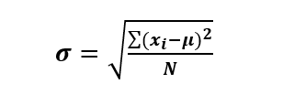
Matrix Normalization
Uses Standard Deviation to normalize.
How to find Standard Deviation?
Find the average of the inputted matrix.
Find the summation for every (x_{i}-avg)².
Divide it by N.
Find the root of the whole product. That’s the SD.
Now divide every element with the SD.
The function for Normalizing the matrix:
The function for finding SD:

Slide 6
Hadamard Matrix
Initializes the reduced matrices.
What is a Hadamard Matrix?
A square matrix whose entries are either +1 or −1.
Dimensions are always 2^{n}x2^{n}.
1 | 1
1 | -1
A basic Hadamard matrix of 2¹x2¹ dimension

Slide 7
Hadamard Matrix
1 | 1 | 1 | 1
1 | -1 | 1 | -1
1 | 1 | 1 | 1
1 | -1 | 1 | -1
A higher dimensional (2²x2²) hadamard matrix made of 2¹x2¹ dimensional hadamard matrix.
A 2x2 dimensional hadamard matrix.

Slide 8
Initialization using Hadamard Matrix
Divide every element by (2)^{n/2} and make it normalized.
Reduce Dimension according to the reduced matrices.
Uses Diagonal Matrix to reduce dimension.
1 | 1 | 1 | 1
1 | -1 | 1 | -1
1 | 1 | 1 | 1
1 | -1 | 1 | -1
0.5 | 0.5 | 0.5 | 0.5
0.5 | -0.5 | 0.5 | -0.5
0.5 | 0.5 | 0.5 | 0.5
0.5 | -0.5 | 0.5 | -0.5
(1/2^{2/2})*

Slide 9
Diagonal Matrix
What is a diagonal matrix?
Diagonal values are >0.
Without diagonal values, everything are 0.
1 | 0 | 0 | 0
0 | -1 | 0 | 0
0 | 0 | 1 | 0
0 | 0 | 0 | -1
How to create one?
Construction of a diagonal matrix
The elements are only 0, 1 & -1.
Diagonally placing just 1 & -1.
The probability to place 1 & -1 is (½).
A diagonal matrix made of 1 & -1 with ½ probability.

Slide 10

Reduce Dimension in Hadamard Matrix
N=The dimension (number of rows/columns of the Hadamrd matrix)
K= In which dimension the matrix will be reduced (Number of reduced rows or columns).
Random selection of rows or columns.
Diagonal matrix
Hadamard matrix
Reducing matrix
The Function to create Hadamard matrix:

Slide 11

Euclidean Distance
Used to check error between original and reduced matrices.
How it works?
Multiply the reduced matrices after one iteration in multiplicative update.
Subtract every values element wise. And square it.
Calculates the error between original and reduced matrices.
Check if the error is less than a particular epsilon.
Check error at every iteration.
The function for error checking:

Slide 12

Multiplicative Update
Used to find the reduced matrix.
How it works?
Keep one of the reduced matrix constant & change the other one
Then, keep the other one constant and change the first one.
Calculates the error between original and reduced matrices.
Check if the error is less than a particular epsilon.
Check error at every iteration.
Now divide every element with the SD.
If it is less than a particular epsilon; then, finish the program and print the answer.

Slide 13
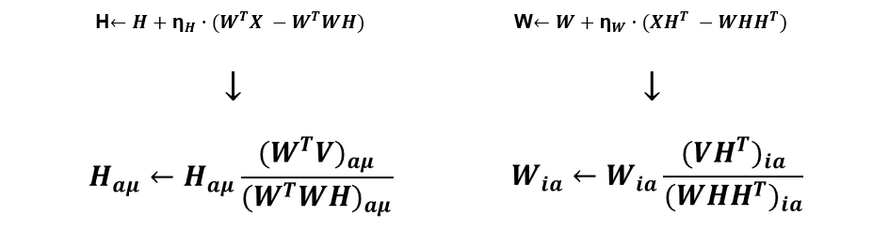
Multiplicative Update
Let, V=WH where V is the original matrix and W and H be the factorized matrix. The multiplicative update runs using the given equation.
Here one matrix is kept constant and another one is changed and thus, we try to get closer to the final value.
The functions for Multiplicative Update:

Slide 14
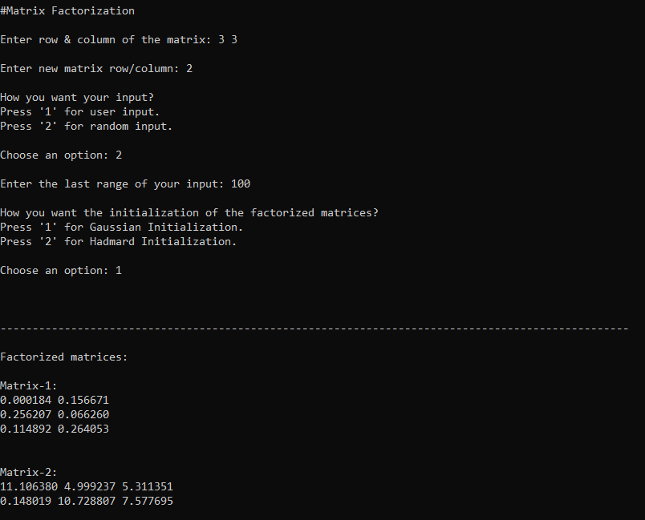
Output of Matrix Factorization

Slide 15
Different Matrix Operations

Slide 16
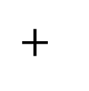
Addition of Matrices
Element-wise addition of two matrices.
A_{i,j}= (B_{i,j}) + (C_{i,j})
a | b
c | d
e | f
g | h
i | j
k | l
a+g | b+h
c+i | d+j
e+k | f+l
(3*3)
(3*3)
(3*3)
The function for Matrix Addition:

Slide 17
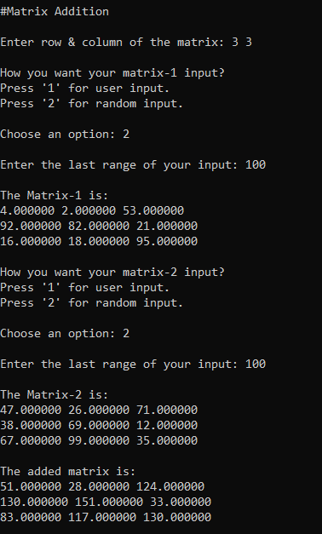
Output of Addition of Matrices

Slide 18
Subtraction of Matrices
Element-wise subtraction of two matrices.
A_{i,j}= (B_{i,j}) - (C_{i,j})
a | b
c | d
e | f
g | h
i | j
k | l
a-g | b-h
c-i | d-j
e-k | f-l
(3*3)
(3*3)
(3*3)
The function for Matrix Subtraction:

Slide 19
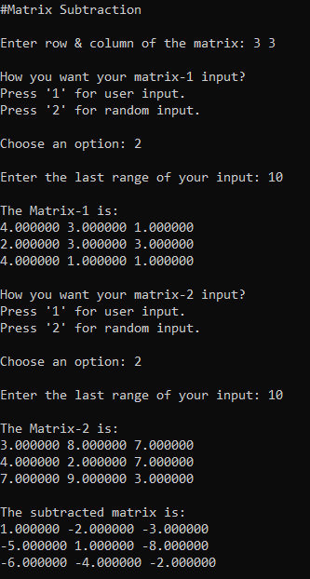
Output of Subtraction of Matrices

Slide 20

Multiplication of Matrices
Dot multiplication between every rows of first matrix with every columns of second matrix.
A_{i,j}= (B_{i,k}) x (C_{k,j}) + (A_{i,k}) x (C_{k,j}) + (A_{i,k}) x (C_{k,j})
a | b | c
d | e | f
g | h
i | j
k | l
ag+bi+ck | ah+bj+cl
dg+ei+fk | dh+ej+fl
(2*3)
(3*2)
(2*2)
The function for Matrix Multiplication:

Slide 21
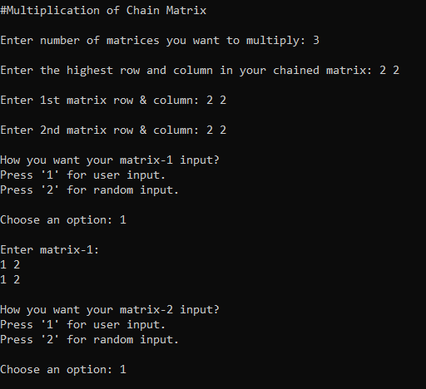
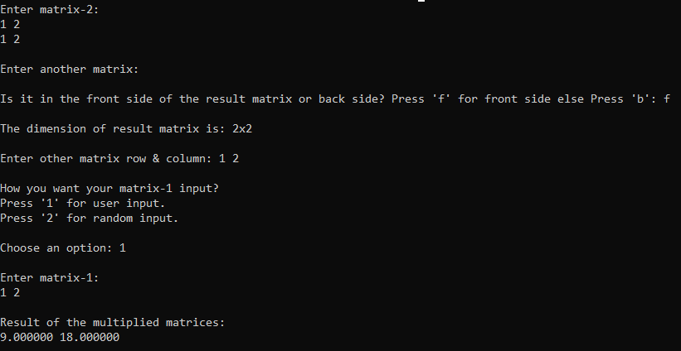
Output of Multiplication of Matrices

Slide 22
Transpose Matrix
Transforming the row into columns and columns into rows.
a | b
c | d
e | f
A_{i,j}= A_{j,i}
a | c | e
b | d | f
(2*3)
(3*2)
The function for Transpose Matrix:

Slide 23
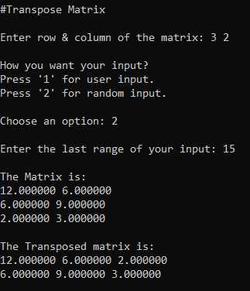
Output of Transpose Matrix

Slide 24
Determinant of a Matrix
|Det| = a (ei − fh) − b (di − fg) + c (dh − eg)
How can we find determinant for more than 3x3 dimension?
Pass the original matrix to a sub matrix creator.
Sub matrix reduces the current element’s row and column.
This goes on until the dimension is reduced to 2x2.
A recursive function.
a | b | c
d | e | f
g | h | i
‘Det’ matrix
The function for Determinant of a Matrix:
The function to create a Sub- Matrix:

Slide 25
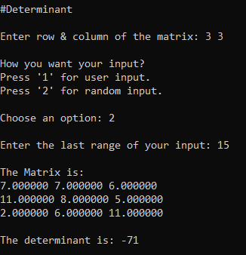
Determinant of a Matrix

Slide 26
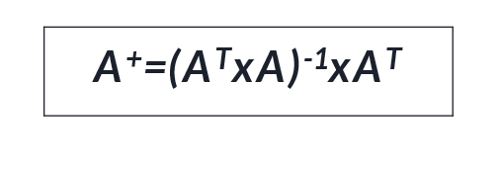
Pseudo inverse of a matrix
A matrix inverse-like object that may be defined for a complex matrix, even if it is not necessarily square
How it works?
Find the determinant. If it’s not 0 then continue.
Find the transpose and multiply it with the original matrix.
Now find the inverse of it.
Again multiply with its transpose matrix.
Typically, can find the inverse for every square and non square matrices.
The function for finding the Inverse of a Matrix:

Slide 27
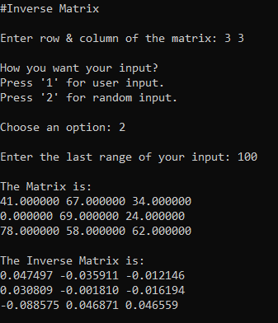
Output of Pseudo inverse of a matrix

Slide 28

Gauss_Seidel Method
An iterative technique for solving a square system of n linear equations with unknown x.
Can solve any amount of equations.
Coefficient matrix needs to be diagonally dominant.

Slide 29

Ways of Gauss_Seidel to Solve Eqn.
x=0 y=0 z=0
Initial values
Initializing x,y,z with 0
First place the value of y,z in eqn-1 and get the value of x
Then place the value of x and z in eqn-1 and get the value of y
Then place the value of x,y in eqn-3 and get the value of z
Then again repeat the ways until we get a low error.
The function to solve linear eqn. Using Gauss-Seidel :

Slide 30
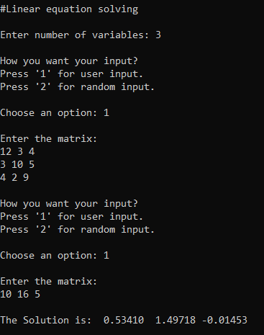
Output of Linear Eqn. Solving

Slide 31


Random Number Generator
Uses Normal Distribution to generate.
Why needed?
If we have a matrix of 10000x10000 dimension. It is not possible for us to input its values manually. So need to use random number.
How to generate?
Take a random number from in built random number generator.
Place it in the formula of normal distribution.
More likely, picking a value from normal distribution.
Can generate values between a range.
The functions to generate random number :

Slide 32
Challenges
Finding the actual algorithms of multiplicative update.
Understanding the derivations of the algorithms.
Working with big data and handling it.
Making a user-friendly program.
Factorization was not working for some inputted matrix, handling was a big challenge.
Working with header file for the first time.
Working with more than 1 C++ files.
Passing a 2D matrix in a function and getting the result from it.
Allocating memory for every matrix was quite a challenge.
Handling large code for the first time.
Implementing mathematical notations in code.

Slide 33
Future Plan
Want to a graphical interface for this.
Want to implement all the algorithms of matrix factorization process to see which one is more efficient.
Most importantly, I want to make a application based of matrix factorization.

Slide 34
Thank You

